Slide 1
LENDING CLUB CASE STUDY SUBMISSION
Group Members:
Niraj Kumar
Arjun Ashok Kumar

Slide 2
Lending Club Case Study Analysis
Lending Club is the largest online loan marketplace, facilitating personal loans, business loans and financing of medical procedures. It's largest source of credit loss is lending loans to ‘risky’ applicants.
Lending Club wants to identify the risky loan applicants, so that such loans can be reduced thereby cutting down the amount of credit loss.
Our aim is to find the driving factors behind loan getting default.

Slide 3
Problem solving methodology
DATA PREPARATION
DATA ANALYSIS
Removing the null valued columns, unnecessary variables and checking the null value percentage and removing the respective rows.
Read the csv files using proper encoding.
Analyzing the continuous data columns with respect to the categorical column.
Analyzing the two variable behavior like term and loan status with respect to loan amount.
Check for outliners and remove unwanted
records
Analyzing each column, plotting the distributions of each column.
Analyzing all plots and recommendations for reducing the loss of business by detecting columns best which contribute to loan defaulters.

Slide 4
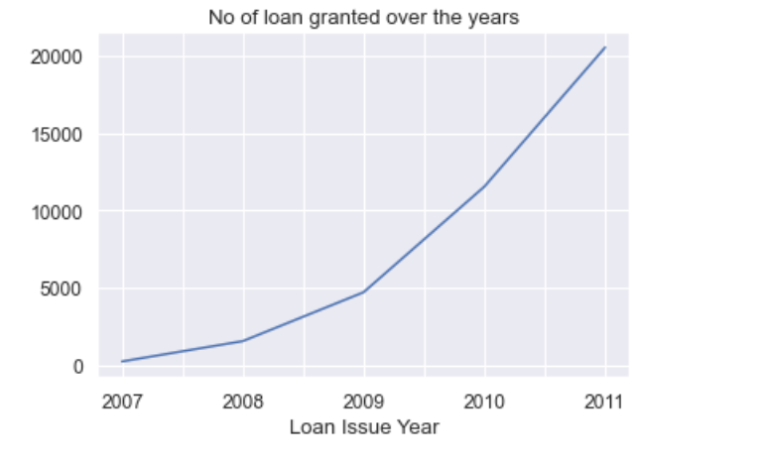
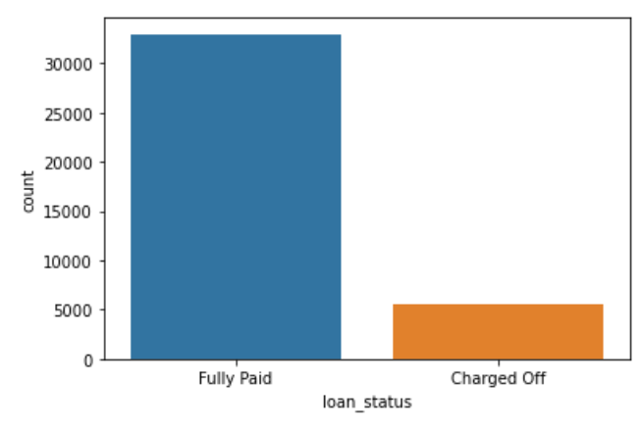
Loan Status Analysis
Observations:
1. Most of the loans are Fully Paid.
2. About 14% of loan are having status as defaulters.
3. The loan has been increasing exponentially over the years.

Slide 5
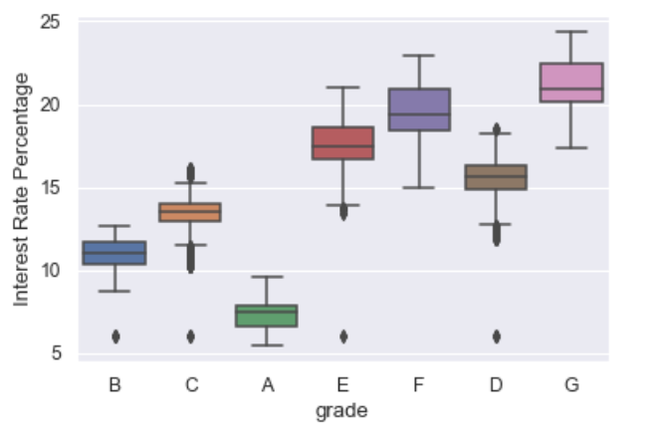
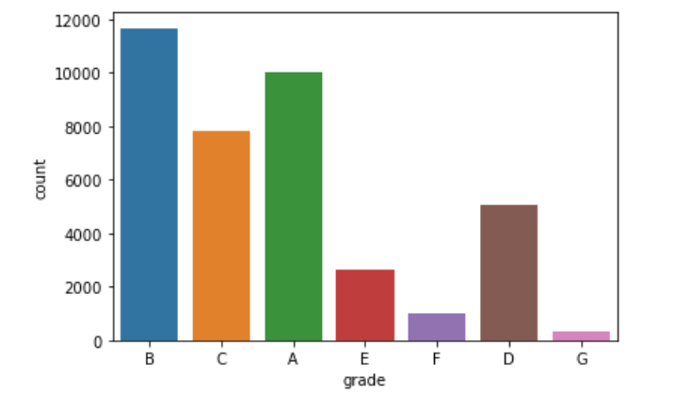
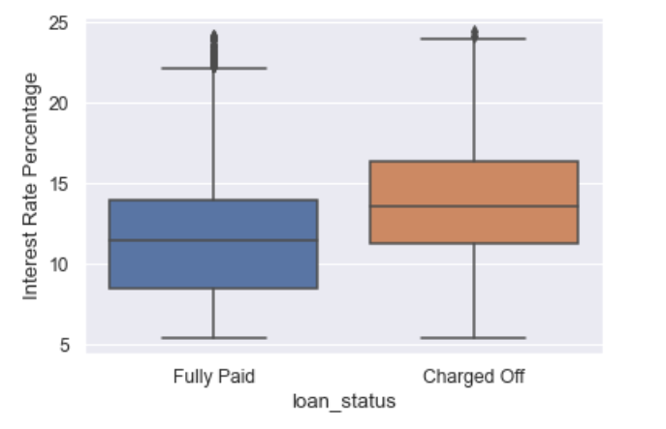
Loan Grade Analysis
Observation:
1. Most of the loans have grade of A and B. Therefore stating
most of the loans are high graded loans.
2. High Quality loans have low interest rate.
3. Higher interest rate have higher tendency to
default the loan

Slide 6
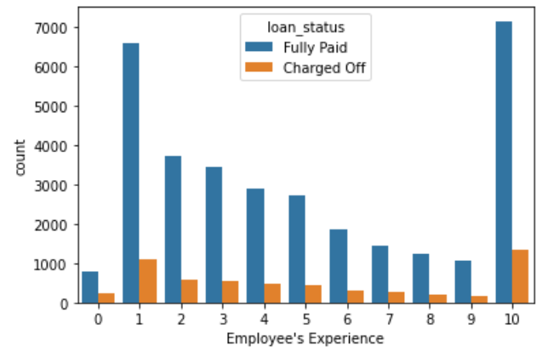
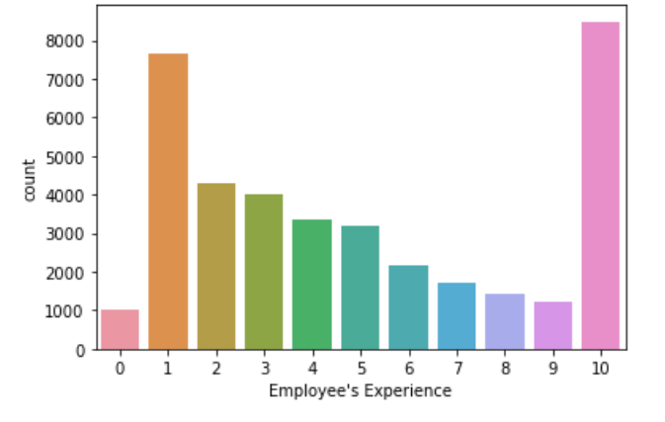
Loan Applicants Work Experience Analysis
Observation:
1. Majority of employees applying for the loan have more than 10 years of experience
2. Tendency of person to default the loan with 10 years of experience is also high. So company need to be careful
when granting loan.

Slide 7
Analysis

Slide 11
Conclusions

